Slide 1
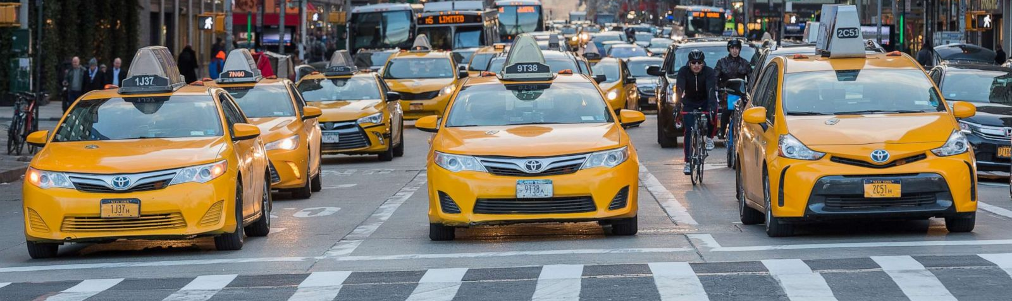
TAXI MANGMENT SYSTEM
:Presented by
Ron Beraha and Tali Shushan

Slide 2
System Requirements
As part of the optimization procedure and the growing need for taxi’s around the world and less and less people owning a car we wanted to make a system that will make it easy for a Taxi company to have access to all of its information.
The system helps Owner to see info about the employees of the company and the station events in order to know what employees are doing a good job what app helps the business the most and they have all the information about the events in any specific station.
In the local manager perspective, the system can help by giving quick and updated log of all current employees and see salaries keep tack on insurances and more

Slide 3
General description
The station has an id, street, telephone number, and city.
At the station there are employees.
Every employee has an id, name, start date, age, salary, address and station.
There are different kinds of employees: Drivers and Receptionist.
Drivers own a taxi car and handle actual events
Receptionists receives event calls and handle them.
In the station there are many events call and actual events.
Every event call has an id, client name, station number, address, date, receptionist id and time.
Some event calls can become actual events and are send a driver to handle.
Actual events have a price, a driver, a matching event id to the call and the time the driver has arrived.
Taxi cars have their driver id, car model, insurance date and the station they are a part of.
The station also can be a part of a few taxi apps and have the information about the monthly subscription price, clients got from said app and the station it’s working with.

Slide 4
Users:
1. Company manager – The company CEO / CFO can keep tracks of all his stations and see how they are doing and even get more specific details in case he needs to inspect some instences.
2. Local station manager – The station manager can use the system to check his day-to-day events, workers, salaries, car insurances and much more…

Slide 5
ERD:

Slide 6
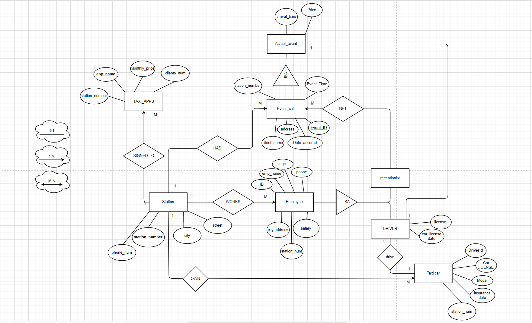

Slide 7

Entities
Station
ID, Phone Number, City, street.
Employee
ID, Name, Phone Number, address, salary, Join Date, Station ID.
Recptionist
ID
Driver
ID, license number, car license Date
Taxi Car
Driver ID, car license, model, insurance date, station ID.
Event Call
ID, Client name, address, date, time, receptionist ID, station ID.
Actual Event
ID, arrival time, price, Driver ID
Taxi apps
App name, monthly price, clients number, station ID.

Slide 8
EER:

Slide 9
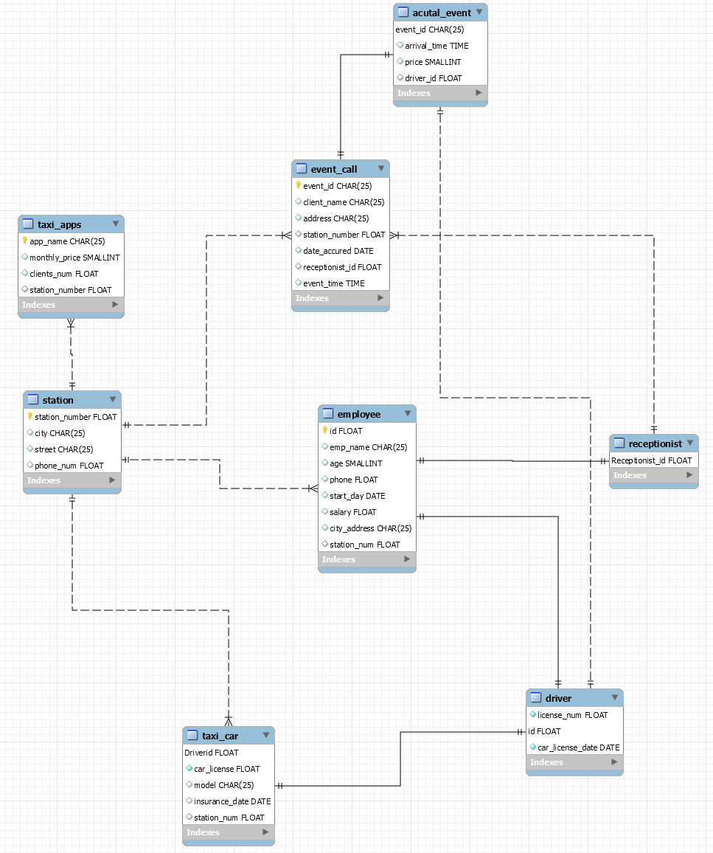

Slide 10
Normalization
We try and follow the three rules of normalization.
All values in a row are atomic values and can’t be separated into smaller values.
Every table has a not null primary key and all primary key columns on the entities are not dependent on each other.

Slide 11
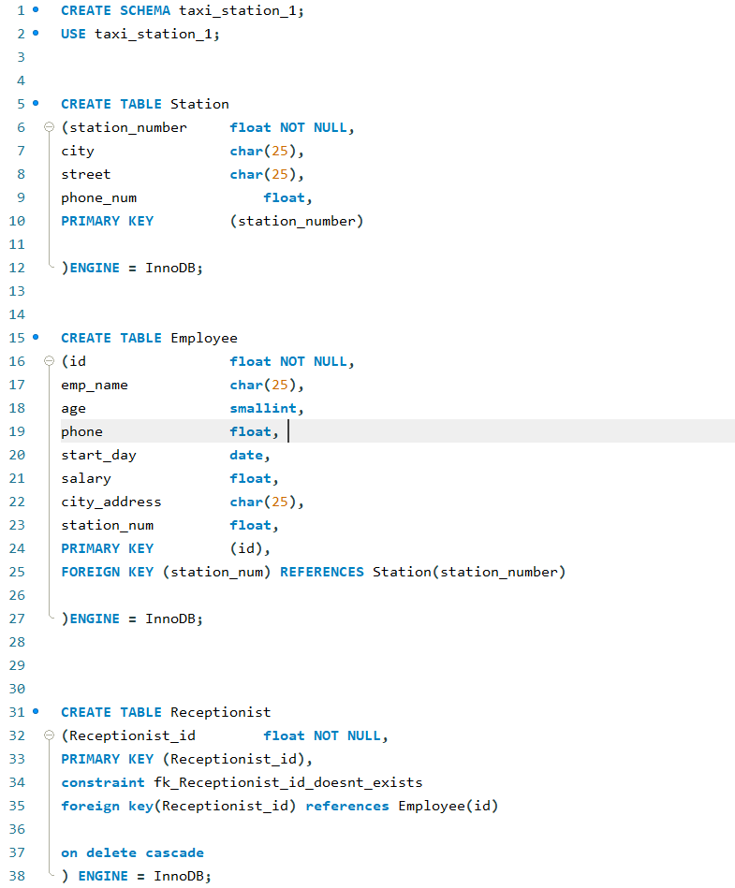
Data Base Creation

Slide 12
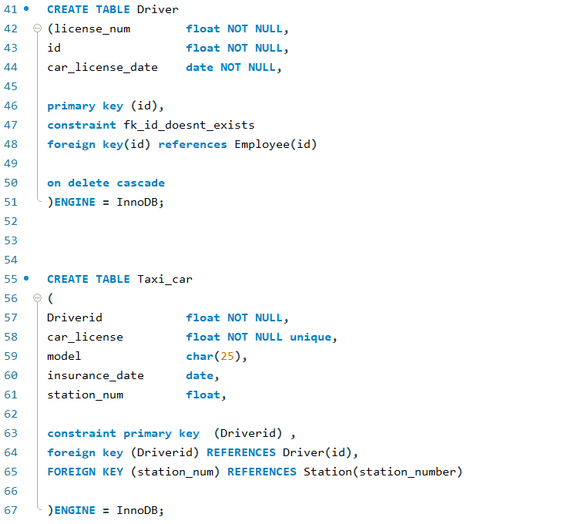
Data Base Creation

Slide 13
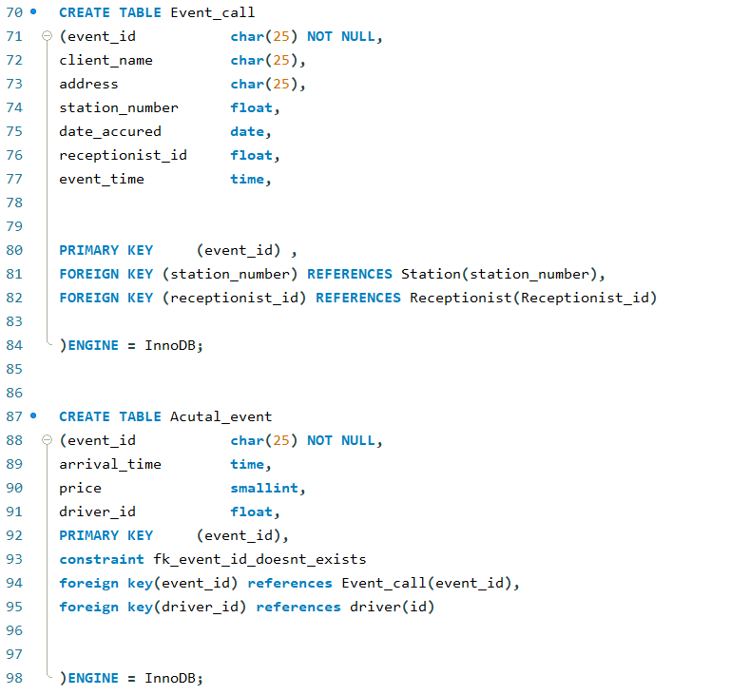
Data Base Creation

Slide 14
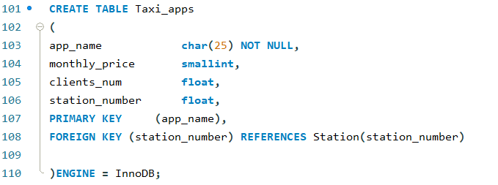
Data Base Creation

Slide 15
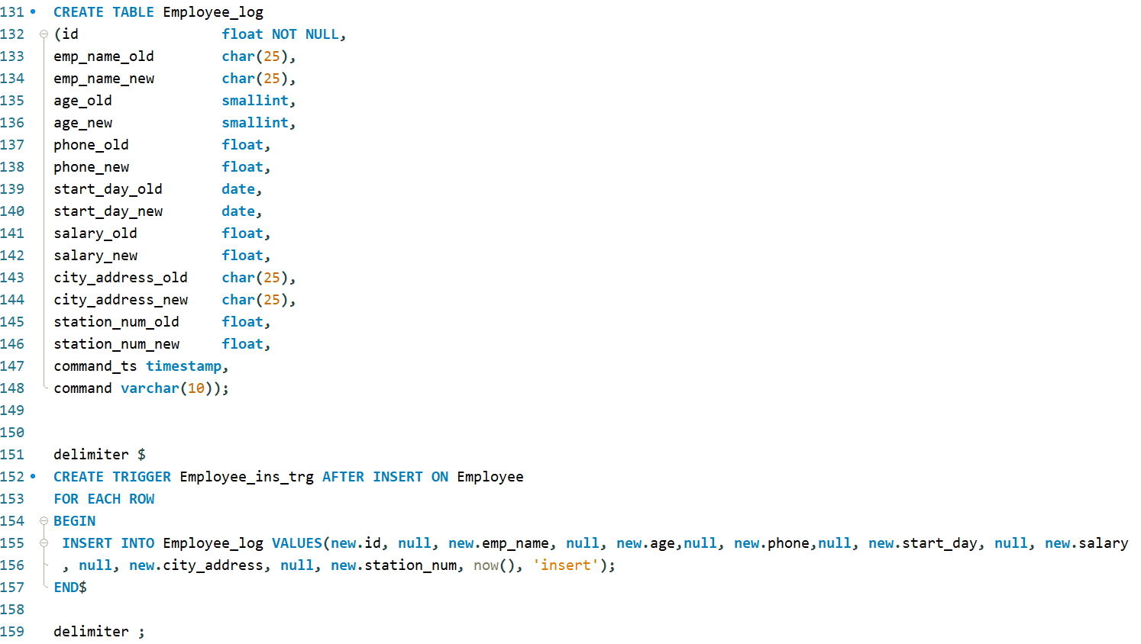
TRIGGY

Slide 16
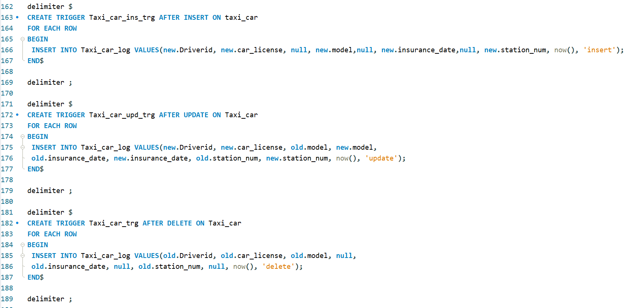
TRIGGY

Slide 17
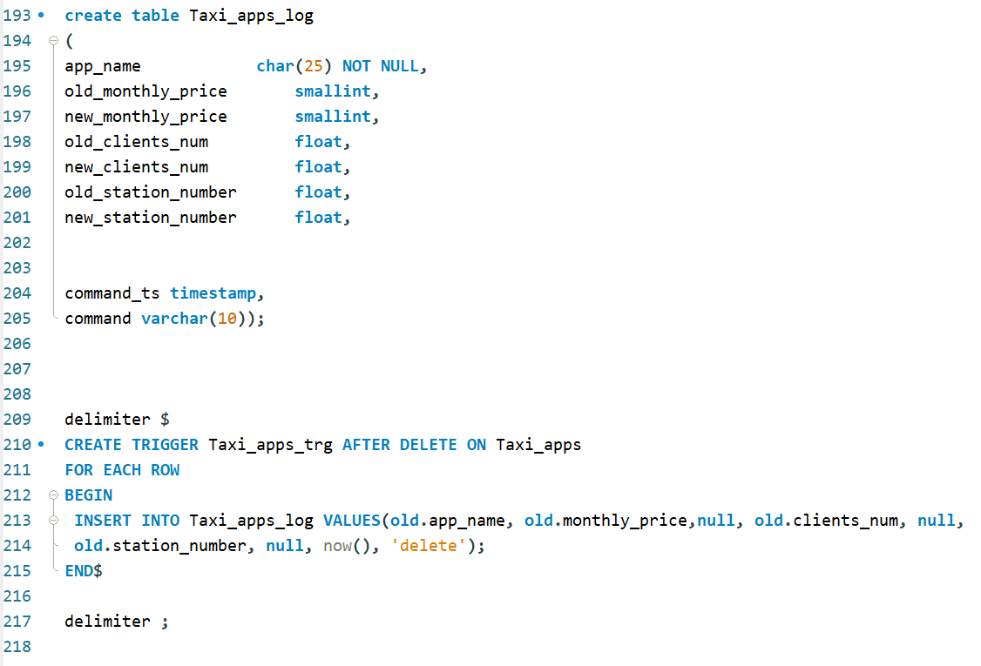
TRIGGY

Slide 18
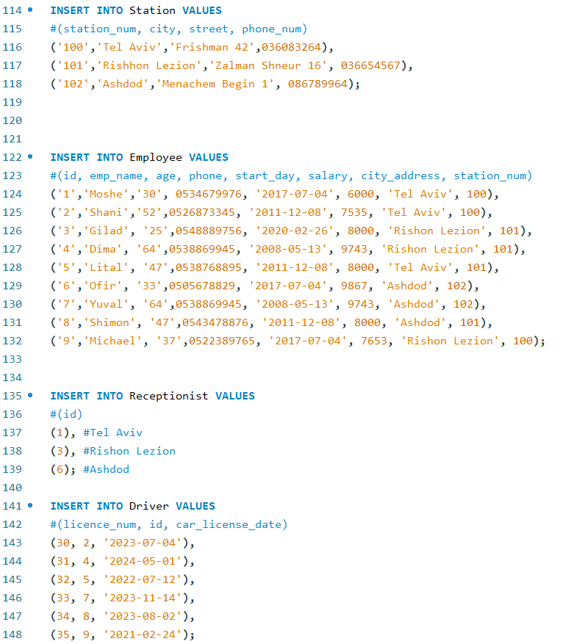
INSERTION

Slide 19
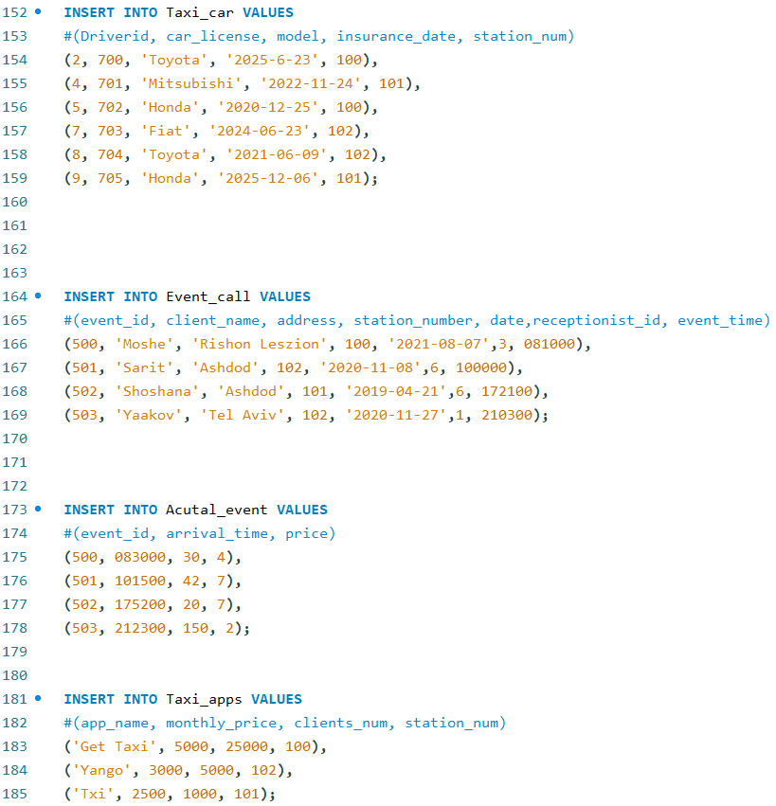
INSERTION

Slide 20
Quires

Slide 21
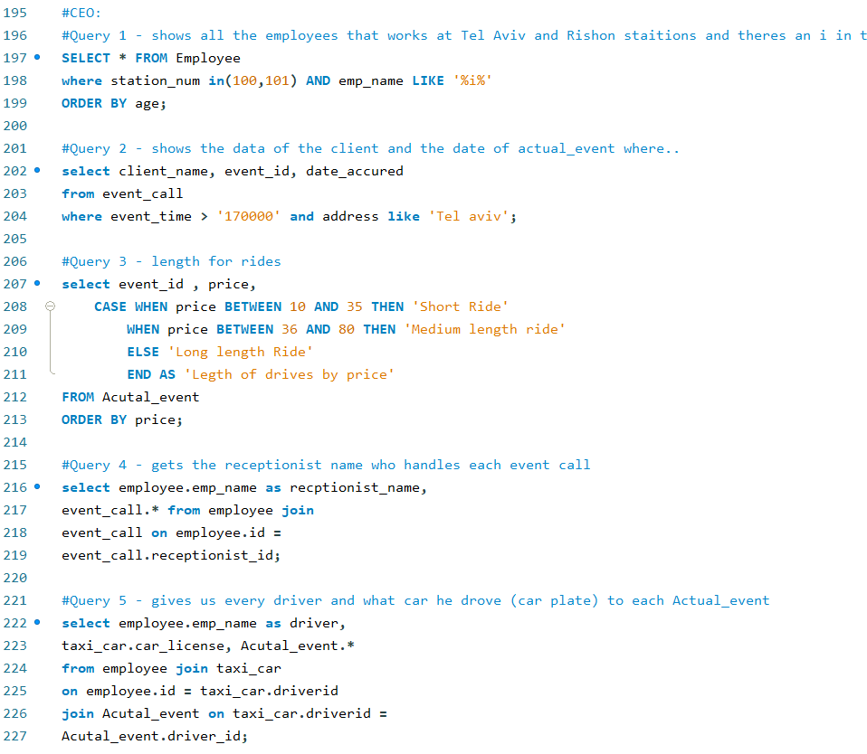
CEO QUIERIES

Slide 22
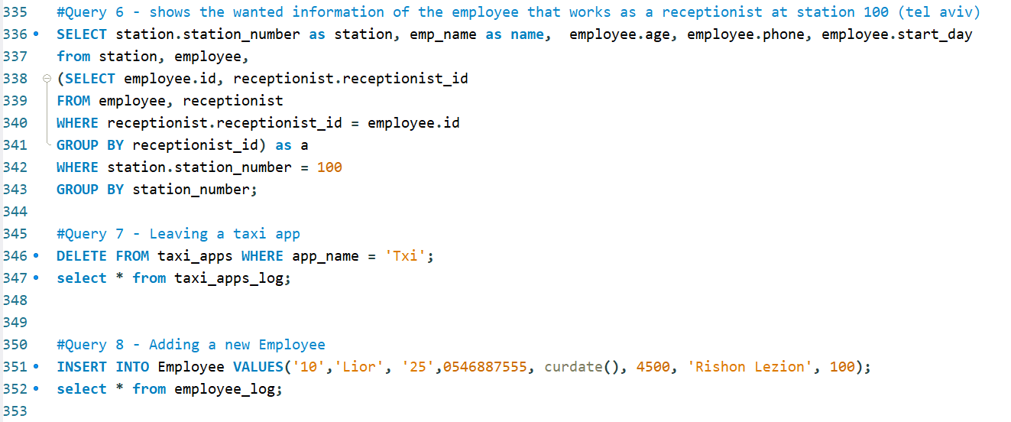
CEO QUIERIES

Slide 23
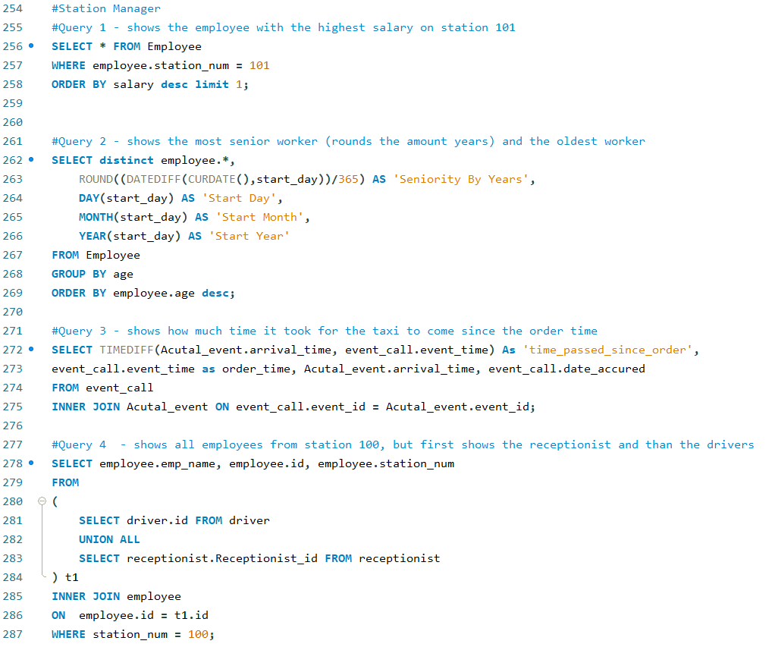
Station Manager QUIERIES

Slide 24
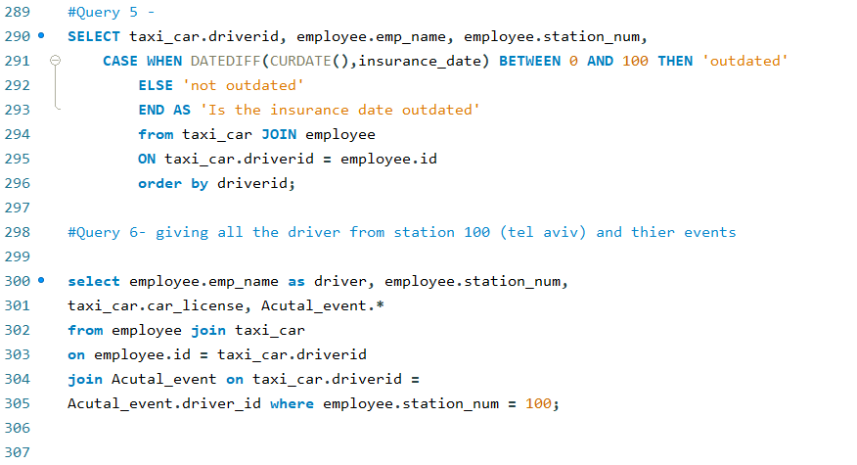
Station Manager QUIERIES

Slide 25
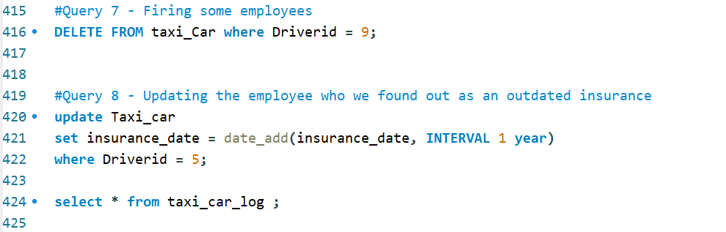
Station Manager QUIERIES

Slide 26


